Slide 1
Prometheus
Adam Goldsmith, Jack Gonsalves, Ben Gillette, and Luke Buquicchio

Slide 2
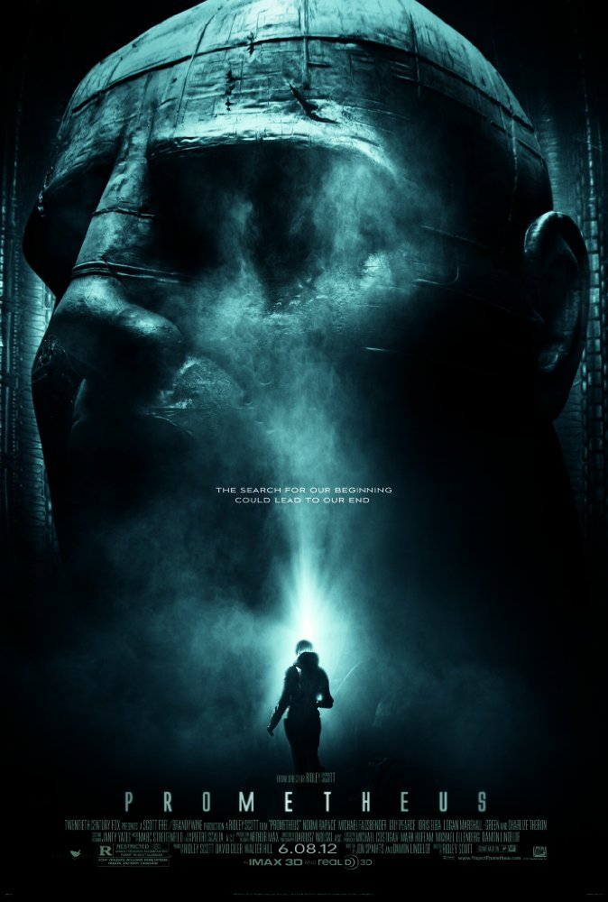
Synopsis
Have you ever wanted to travel to new and exciting places?
Have you ever wanted to “meet your maker?”
Have you ever wanted to kill your maker?
Image from http://www.imdb.com/title/tt1446714/
Notes:
**Spoiler Alert**
The movie Prometheus is about 2 archaeologists discovering the origins of life on Earth.
All signs indicate a race of humanoids lovingly called the Engineers on a planet roughly 35 light years away.
The Weyland Corporation, offers to fund their mission to meet our makers.
Over the course of the mission they find alien life and evidence of a struggle for survival aboard a marooned ship.
Eventually some of the crew become infected with a pathogen and begin to mutate.
Many of the crew members die as a result and the mission is in jeopardy.
It is at this point that the secret mission agenda is revealed as the CEO of the corporation makes an appearance and attempts to contact an Engineer.
His goal was to find immortality and his greed abruptly ends the mission with total disaster as the engineer perceives them as threats and attempts to kill them.

Slide 3

David 8
A sentient android helper
Advanced human interaction with “emotions”
Is David morally responsible?
Image: http://www.australianscience.com.au/news/the-clues-to-human-uniqueness/
Notes:
The most interesting technology in Prometheus is David 8.
David 8 is the latest in advanced androids made by Weyland Industries. He is designed to seem human: at one point in the movie, he is asked why he is putting on a space suit, since he does not need it, and replies that it is to make the humans feel more comfortable.
He also has experimental emotions, but they just make him seem kind of like a sociopath instead of a more typical robot: instead of just not understanding the emotions of people, he seems to understand but not care.
A major question with David is whether or not he is a moral agent, since he does some distinctly evil things, such as intentionally infecting a crew member with the pathogen.
Our conclusion is that as long as Weyland (or someone to give him orders) is alive, David is not a moral agent. The argument being:
Since Weyland can define his orders, he does not have free will.
Elizabeth Shaw: What happens when Weyland is not around to program you anymore?
David: I suppose I’ll be free.
Elizabeth Shaw: You want that?
David: “Want”? Not a concept I’m familiar with. That being said, doesn’t everyone want their parents dead?
Elizabeth Shaw: I didn’t.
In Alien: Covenant, he is shown to have free will and creative desires
Therefore, he will be a moral agent
As opposed to the robots in Westworld, who are programmed to be violent, David’s desire to be evil seems to be his choice
Also, he apparently has unlimited memory, and has all of his “smarts” in his head, which can run independently.

Slide 4
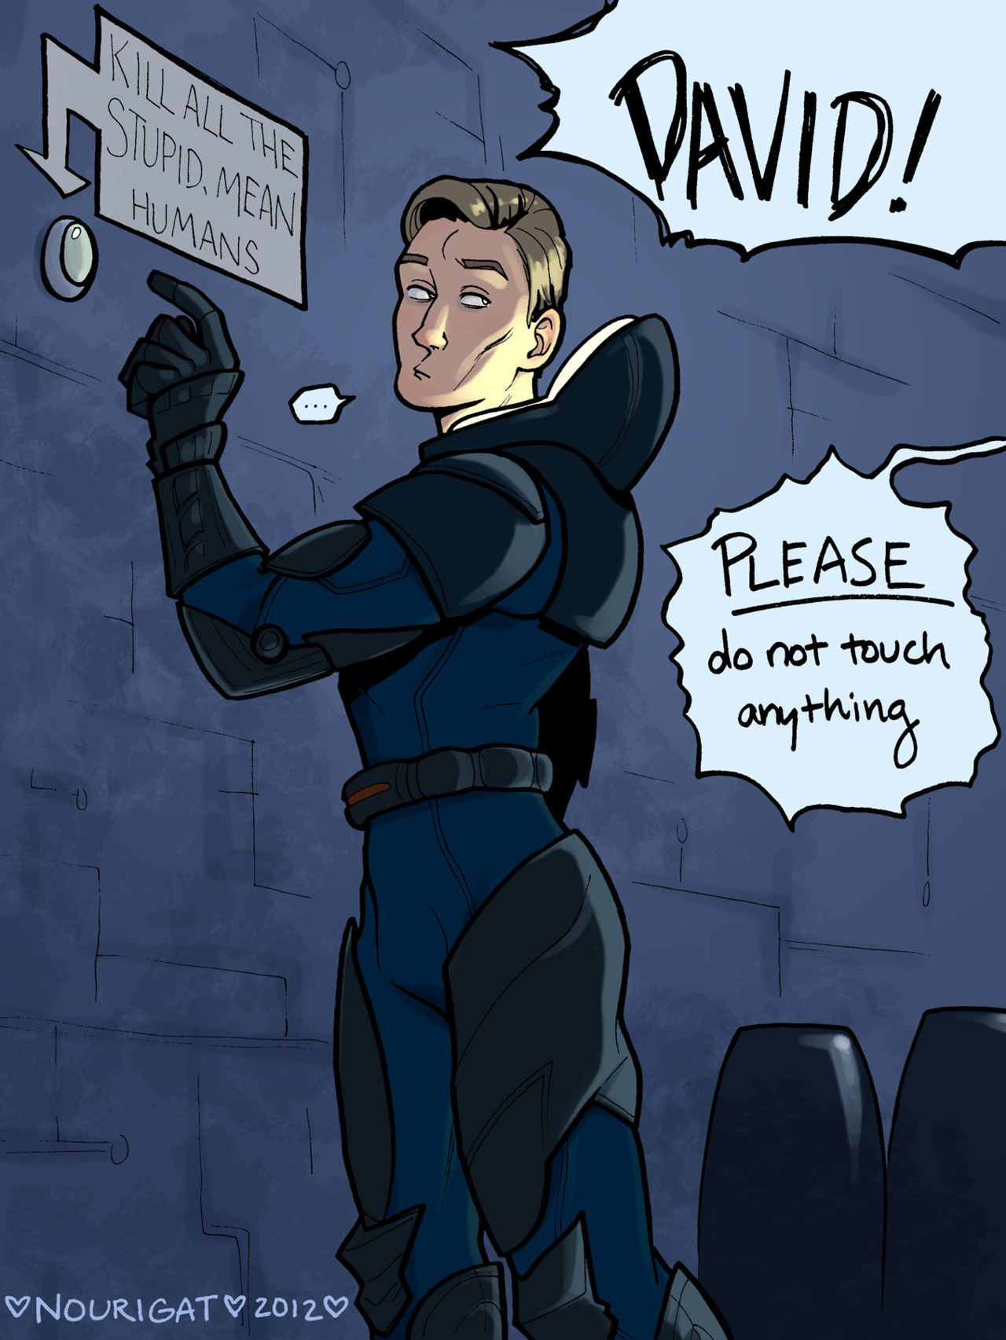
David 8 & Ethics
Does giving him an order count as slavery?
Is he evil?
Was his creation morally wrong?
Image: http://tally-art.tumblr.com/post/24799708571/david-from-prometheus-faaavorite-character-3-i
Notes:
If David is sentient, which all evidence seems to point to; then giving him orders that deny him his choice is, by definition, using someone as a means to an end and is equivalent to slavery. While the people giving the orders might not know that; it is still wrong.
Given that David is sentient, are his actions “evil?” He does a number of things that are morally wrong, including poisoning a crew member and spying on someone’s dreams. This will be covered slightly more in a later section.
If David is evil, was his creation morally wrong? By the ACM SE code of ethics, the engineers are obligated to make him safe, which they obviously have not done. His marketing states that “He will not flinch at even the most disturbing or seemingly irregular assignment, and he will dutifully persevere until reaching his final objective,” [1] so obviously the marketing department knows that he has no moral compass.

Slide 5

Automation
Positive use of automation
Android: Enables long-term mission
Scanning robot: valuable new tool
Notable lack of automation
<Graphic>
Image from http://alienanthology.wikia.com/wiki/Spectagraph
Notes:
Despite the negative portrayal of advanced AI, the movie actually portrays more or less a best-case scenario for use of automation: robots do not replace human jobs; instead they perform tasks that would be difficult or impossible for humans in order to allow the humans to expand their own scope of activity.
David’s initial role, monitoring the crew while they were in stasis, is one such task. Given the unreliability of the stasis machines, it seems likely that extended stasis wouldn’t have worked without David there to monitor things. It also seems likely that the mission couldn’t have happened without stasis: (6 oz. ramen/380 cal)(2000 cal/person-day)(2 years)(365 days/year)(17 people)(1 ton/32000 oz.) = 12.25 tons of food (calorie info: http://www.myfitnesspal.com/food/calories/generic-dry-ramen-noodles-without-seasoning-157375889) Staying awake alone for two years is a prime example of a task that is too monotonous or unpleasant to be done by a human.
The scanning robots (spectrographs, PUPS) represent another expansive use of automation. These drones fly through a massive network of caves and corridors, producing detailed 3D maps of the regions they scan. In order for a human to do this, they would have to proceed through the unknown areas themselves, which would expose them to danger and take much longer than an autonomous scan.
In fact, the workers in the movie could have benefitted from even more automation. Much of the danger in the movie comes from the crewmembers being exposed to various dangerous alien life forms. This could have been avoided or at least substantially mitigated by first sending in an autonomous probe, as has been done in every other space exploration attempt in the past. Spirit and Opportunity can’t catch alien viruses and don’t have to worry about parasitic alien snakes jumping down their throats.
Throughout the movie, automation technology enables new human actions that would not otherwise be possible, rather than replacing human workers
Image: http://alienanthology.wikia.com/wiki/Spectagraph

Slide 6
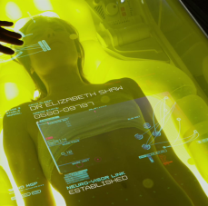
Privacy
Records of the expedition
David used dream eater
It was super concerning
Image From http://www.alien-covenant.com/topic/45629
Notes:
David spied on people while they were sleeping
This would be a clear violation of everyone's privacy.
Quote from http://www.alien-covenant.com/topic/45629 [2]
“A decision Peter Weyland said he based on ‘a man should have the privacy, at least, of his own dreams.’ Yeah, very altruistic, and he wanted the technology all to himself.”
The cryo pods need to have the information so that people's vitals and mental health is all right
Violation of every moral argument no matter how you look at it
Super violation of the code of ethics.
2.05 - keep private any confidential information gained in their professional work… [3]
3.12 - respect[s] the privacy of those who will be affected by the software.
Code of ethics should also apply to the software that you produce. By all of section 7
David's decisions were his own
The whole expedition was recorded.
There were cameras on the ship
Everyone had a body camera on them
Not really a violation because it was a scientific expedition and everything should have been recorded
Like the when people die on the ship and have no more readings so that others can see what happened
Could they have, yes, did they no. no one looked at the recordings of the

Slide 7
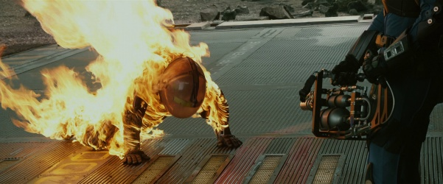
Corporate Space Travel
Corporate environment
Parallels with existing industries
Lack of care for employees
→
Unethical treatment of employees
Notes:
The failure to send in an unmanned probe before sending in human explorers is actually just one of the ways the Weyland Corporation endangers its employees. A short list includes failure to train its employees to properly monitor communication systems, failure to train its employees about safety in hazardous environments, failure to train its employees in general (really, there are too many things to count that could have been avoided if someone had known not to do something stupid), ignoring quarantine procedures, and executing an employee by burning him alive. All of these are serious ethical violations: in failing to address the safety of their employees, the Weyland Corporation treats them as a means to the end of achieving Peter Weyland’s personal desires. Furthermore, the company’s behavior violates several rules of professional ethics: they injure others through malicious action (IEEE COE 9), engage in a dangerous task without taking steps to reduce risk (ACM SE COE 5.01), and do not ensure that their employees have the proper experience/training before putting them to work (ACM SE COE 5.04). Furthermore, the last action is almost definitely illegal (11 Del. C. §5-632, 636, 645) depending on the jurisdiction.[4] [5]
Prometheus takes place in a heavily corporate environment: all of the crew members work directly for Weyland Industries, live on a ship owned by Weyland Industries, are fed by Weyland Industries, and have no way of establishing two-way communications with the rest of the world. This corporate domination of space travel is particularly relevant right now, as private companies like SpaceX take on a larger role in space travel. Furthermore, corporations’ tendencies to mistreat their employees when out of reach of government oversight have well-established real-world parallels; in fact, if anything some of the real-world parallels are actually much worse, as most of the Weyland Corporation’s faults were due to carelessness rather than actual malice. Company towns in the 1800’s sometimes used their isolation and the dominance of the company to use monopolistic company stores to recover salaries from their employees.[6] Modern sea vessels provide an even more direct parallel and even more disturbing examples of abuse: a New York Times investigation found that at sea, “murders regularly occur,” people are rarely held accountable for crimes, and workers are often abused or even abandoned at sea.[7] The execution by flamethrower in Prometheus actually may not be that far-fetched.
If corporations are allowed to operate totally disconnected from Earth with no connection to a regulating government or public view, they will likely be prone to serious acts of abuse.
Image: http://www.imfdb.org/images/thumb/3/30/Prometheus-flamegun3.jpg/601px-Prometheus-flamegun3.jpg

Slide 8
Conclusions
Corporations are likely to act amorally in an isolated environment
Privacy should be respected
Properly implemented automation is beneficial
David is a moral agent
Notes:
To restate,
There needs to be regulation on how corporations treat their employees outside of government owned territory and
part of the regulations needs to include respect for employee privacy.
In addition,
If the automation, namely David, the medpod, and the pups, worked more effectively, the risk to the crew would have significantly been mitigated.
We see this in the first two years of the mission and in the first day on the planet where the automation was working perfectly.
Nobody was harmed and there were significant discoveries.
There were some instances of human error, but that is unavoidable while there are still humans involved.
Those errors led to more deaths than the homicidal robot.
Finally,
David thinks and plans like a moral agent.
His creator had control over him while still living, but he expressed a strong desire to be “free.”
To prove his morality, rather amorality, we look at the scene with the alien abortion and of David confessing to viewing Dr. Shaw’s dreams.
It in no way advanced David’s agenda or improved his position; it was just him taunting Dr. Shaw.
The creators of David were also in the wrong for not programming a moral compass in a sufficiently complex decision-making machine.

Slide 9
References
Fox. (n.d.). David 8. Retreived September 27, 2017 from https://www.weylandindustries.com/david, Archived at https://web.archive.org/web/20170708023855/https://www.weylandindustries.com/david
Association for Computing Machinery. (n.d.). Software Engineering Code of Ethics and Professional Practice. Retrieved September 28, 2017, from https://www.acm.org/about/se-code
Prometheus sequel by Ridley Scott. (n.d.). Retrieved October 04, 2017, from http://www.alien-covenant.com/topic/45629
ACM/IEEE-CS Joint Task Force on Software Engineering Ethics and Professional Practices. "Software Engineering Code of Ethics and Professional Practice." Version 5.2. 2015. http://www.acm.org/about/se-code
IEEE. “IEEE Code of Ethics.” IEEE Policies, Section 7 - Professional Activities (Part A - IEEE Policies). 2017. http://www.ieee.org/about/corporate/governance/p7-8.html
Carlson, Linda. Company towns of the Pacific Northwest, p. 104. University of Washington Press, 2003. https://ebookcentral-proquest-com.ezproxy.wpi.edu/lib/wpi/reader.action?docID=3444573&ppg=110
Urbana, I. (2015, July 17). "Stowaways and Crimes Aboard a Scofflaw Ship." The New York Times. Retrieved October 5, 2017, from https://www.nytimes.com/2015/07/19/world/stowaway-crime-scofflaw-ship.html

